Slide 1

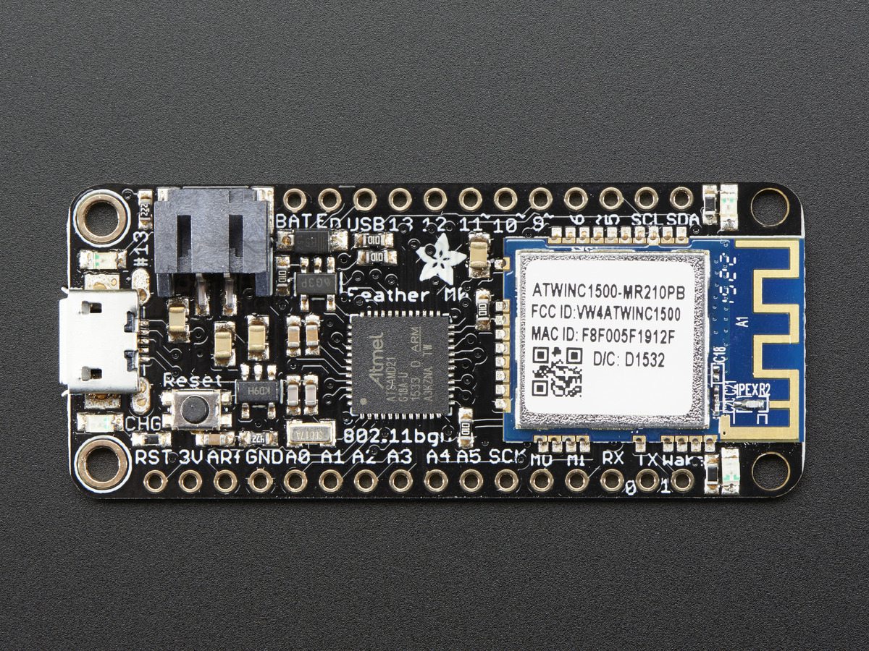
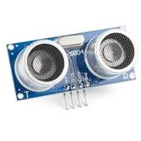
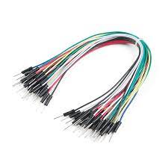
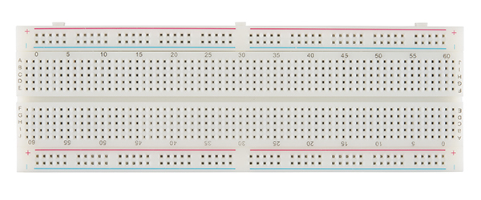
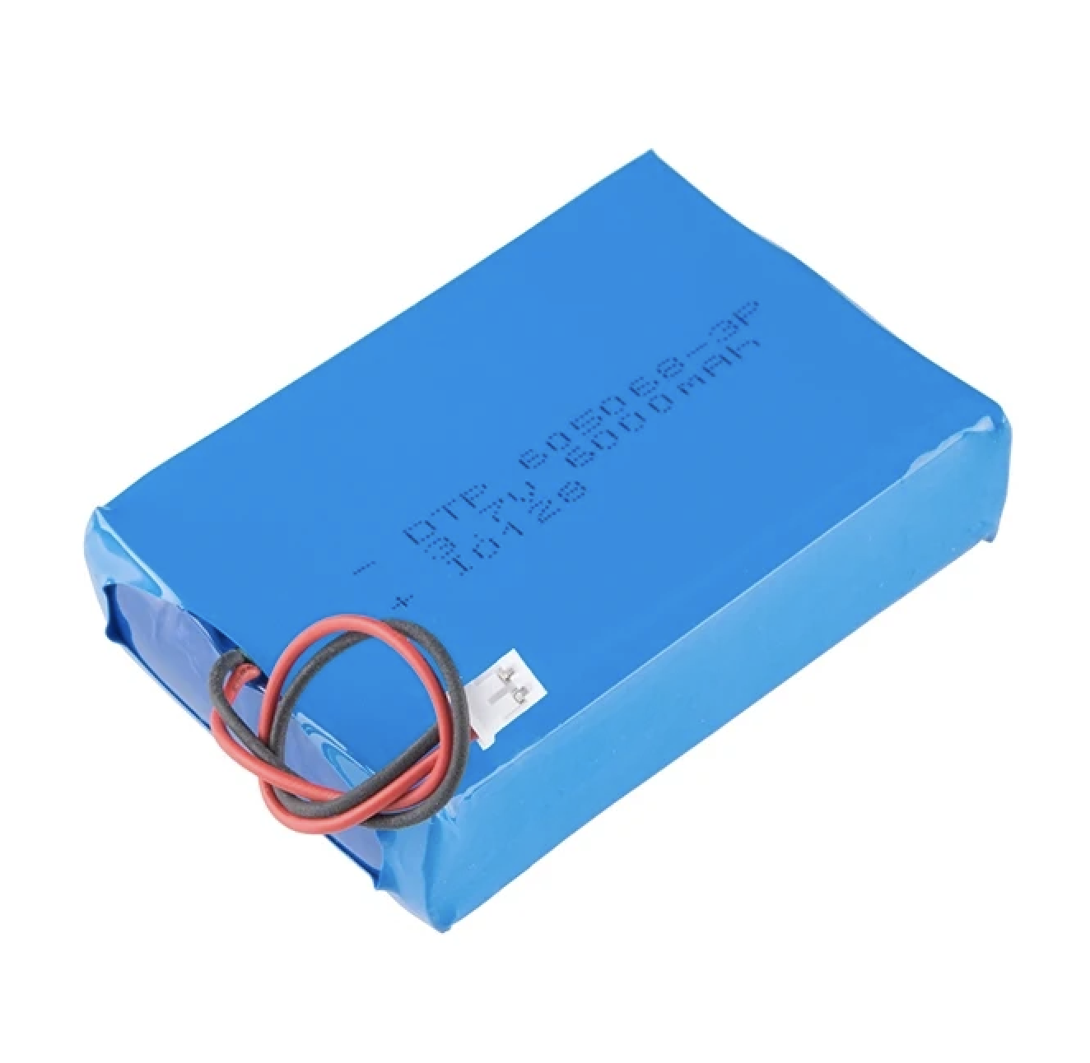

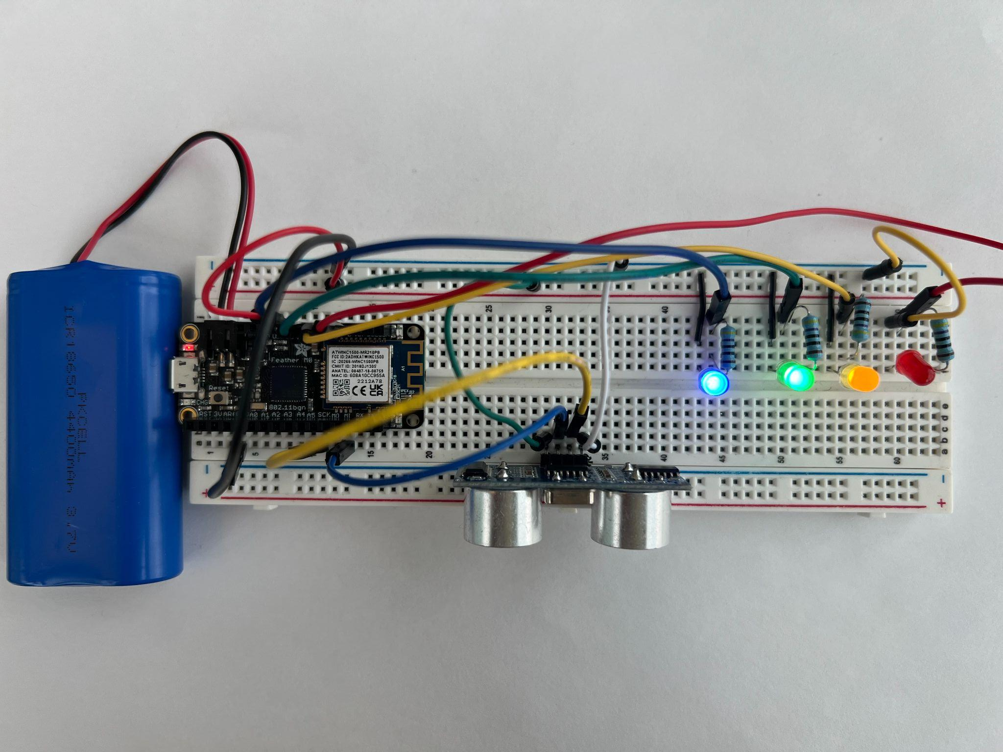
FloodNet Logo -
Build Ultrasonic Sensor with Arduino and LED’s
Build an Arduino Ultrasonic Sensor Circuit with LED’s to Simulate a Flood Sensor
Materials:
Arduino Feather M0 (with WiFi)
1 HC-SR04 Ultrasonic Sensor
9 Color-coded male-to-male flexible wires
1 Breadboard with connected LED’s
1 Lithium Polymer 3.7V battery or Micro USB Charger/Cable
Circuit Diagram (aka Schematic)
The circuit resembles a puzzle, where every connection is crucial. Each wire is color-coded, with black wires designated for grounding (GND). Moreover, each LED is meticulously paired with a resistor in its connection.
Notes:
Go from grounding connections to power connections. Narrative of the loop flow electrictity

Slide 2
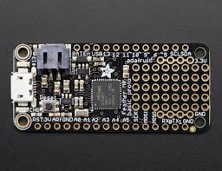

Slide 3
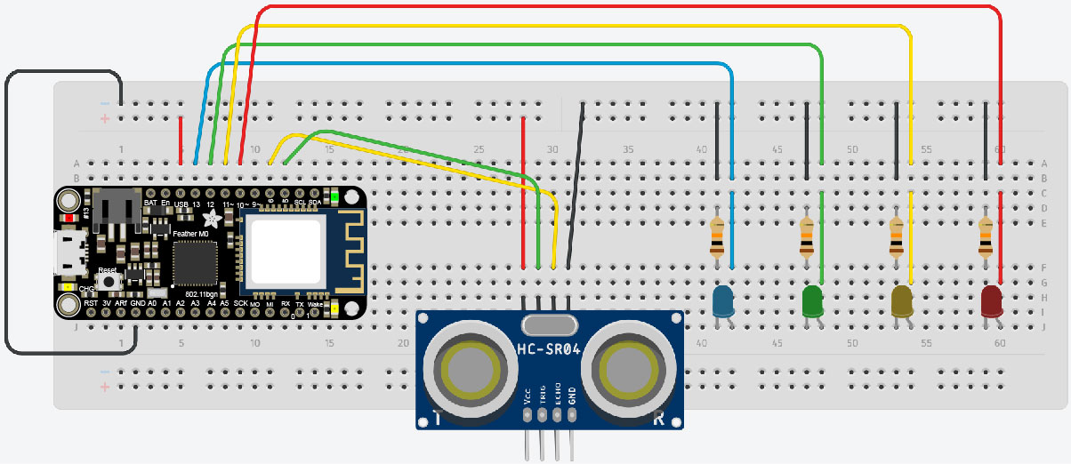
Build an Arduino Ultrasonic Sensor Circuit with LED’s to Simulate a Flood Sensor
VCC Power
GND (ground)
USB - Vcc power
GND - ground
13 - blue led
12 - green led
11 - yellow led
10 - red led
6 - echo
5 - trig

Slide 4
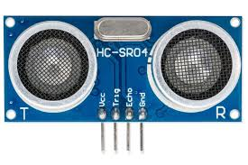
Build an Arduino Ultrasonic Sensor Circuit with LED’s to Simulate a Flood Sensor
Connecting the HC-SR04 Ultrasonic Sensor to the Arduino
Connect the ultrasonic sensor into the breadboard.
Use a red wire to connect the VCC sensor pin to the Breadboard (+) red (power) rail.
Connect the Trig pin to the #22 MISO socket on the Arduino Feather M0.
Connect the Echo pin to the #24 SCK Arduino Feather M0 socket.
Use a black wire to connect the GND (ground) HC-SR04 sensor pin to the negative (-) blue rail on the breadboard.
Use another black wire to connect the negative (-) Breadboard rail to the GND Arduino Feather M0 socket.
Connect Echo Pin to #22 MISO Pin
Connect Trig pin to #22 MISO pin
GND (ground) to (-) blue rail on the breadboard.
VCC Power
GND (ground)

Slide 5
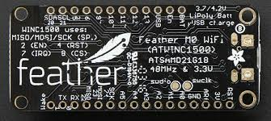
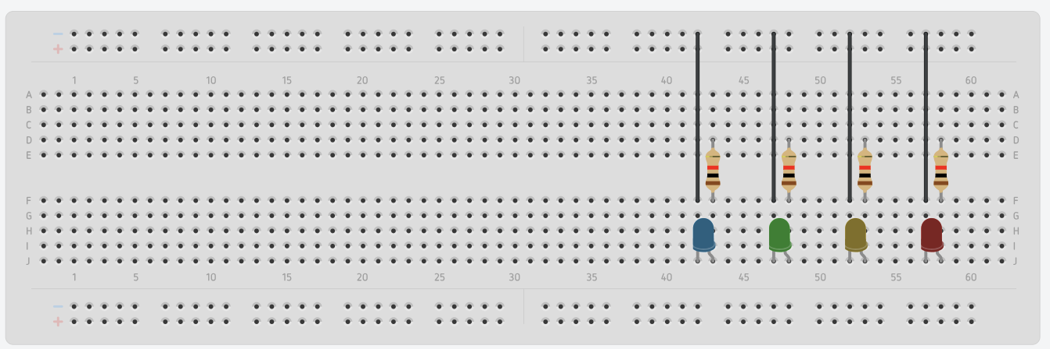
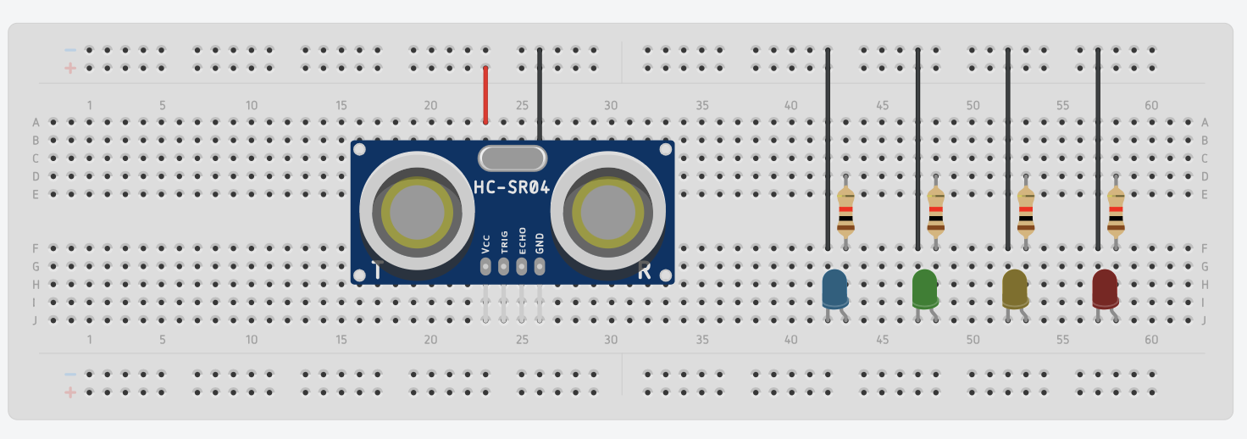
Build an Arduino Ultrasonic Sensor Circuit with LED’s to Simulate a Flood Sensor
Connect the Four LEDs to the Arduino Feather M0
Connect each of the LED’s to the corresponding Arduino Feather M0 power sockets 6 (red), 10 (yellow), 11 (green) and 12 (blue). Notice that each color-coded LED is assigned to a specific socket number on the Arduino Feather M0. Follow the schematic for accurate connection.
Connecting the Arduino Circuit to Power
Take the power cable and connect to the Arduino Feather M0 USB power socket.
Connect the other end to a power source.
Power (USB)
Notes:
Link:https://talkingstuff.net/water-level-indicator-ultrasonic/

Slide 6
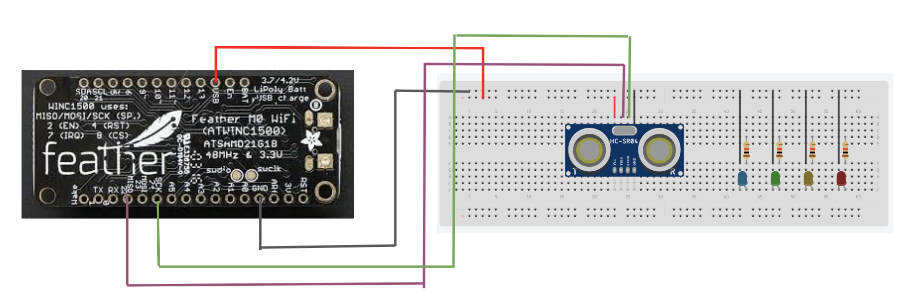
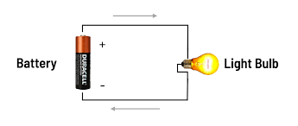
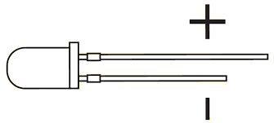
Build an Arduino Ultrasonic Sensor Circuit with LED’s to Simulate a Flood Sensor
Powering and Grounding the Circuit (Double checking your Connetions
In completing the Arduino HC-SR04 ultrasonic sensor and LED setup, electricity flows from the power source connections of the Arduino, through the sensor and LEDs, and back to the ground (GND).
In this setup, connecting LED’s and HC-SR04 sensor to an Arduino Feather M0, the power (3.7 V) is supplied through the USB pin on the Arduino Feather M0. This power flows through the sensor and LED’s and then returns to the Arduino's ground pin GND to complete the circuit.
Both the HC-SR04 ultrasonic sensor and the LEDs need to be connected to the GND socket of the Arduino via the negative (-) rail (blue line) of the breadboard for proper grounding.
Every circuit element needs to be connected to power to allow electricity to flow.
CONNECT TO USB POWER TO activate your circuit
Notes:
Link:https://talkingstuff.net/water-level-indicator-ultrasonic/

